Slide 1

Analyzing the Impact of Car Features on Price and Profitability
Subtitle

Slide 2
APPROACH
Data Collection
Data Cleaning and
Data Preparation
Data Analysis
Dashboard

Slide 3
DESCRIPTION
The automotive industry has experienced rapid growth, with a focus on fuel efficiency, environmental sustainability, and technological innovation.
As competition increases and consumer preferences shift, it is crucial to understand the factors driving car demand. Electric and hybrid vehicles are becoming popular as well as alternative fuel sources like hydrogen and natural gas are also becoming popular. Traditional gasoline-powered cars remain dominant, with varying fuel types and grades available. To optimize pricing and product development decisions, car manufacturers can analyze the relationship between features, market categories, and pricing,identifying popular features and profitable categories.
Data analysis techniques like regression analysis and market segmentation can help manufacturers develop a pricing strategy that balances consumer demand with profitability and focus on product features for future development. This approach can enhance competitiveness and
profitability over time.
Since some of the solutions cannot be shown fully because of size and quality constraint of the screenshot therefore the drive link for the excel File is pasted here for full solution and reference.
The drive
https://docs.google.com/spreadsheets/d/14COd-OetOHOo4M_d3j28W6FXnomK_OB7/edit?usp=sharing&ouid=105378441798796000692&rtpof=true&sd=true

Slide 4


Software Tools
Excel
Power bi

Slide 5
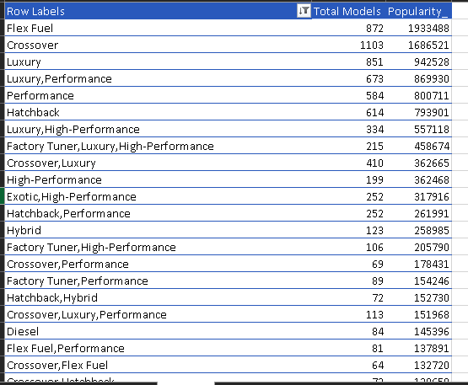
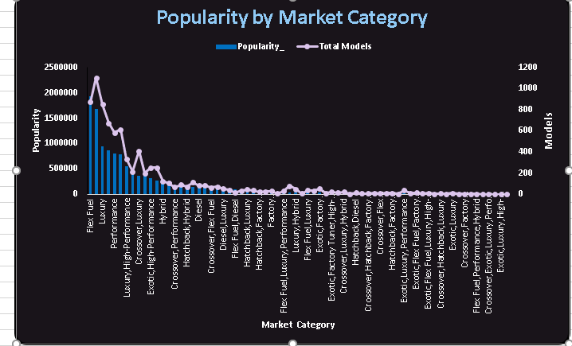
A_Task- 1: How does the popularity of a car model vary across different market categories?
The market category “Flex Fuel” has the highest popularity with a total of 19,33,488 models. It is closely followed by the market category
“Crossover” with a popularity of 16,86,521.

Slide 6
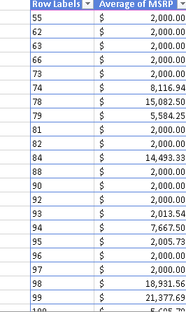
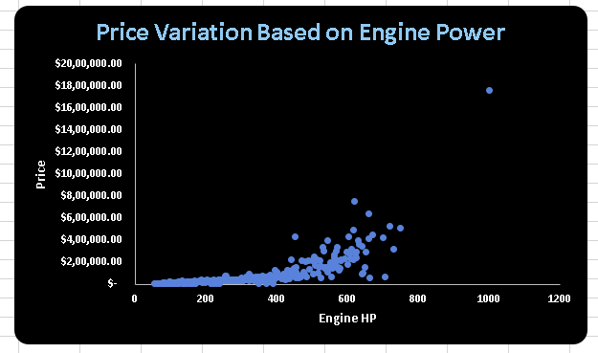
Task 2: Create a scatter chart that plots engine power on the x-axis and price on the y-axis. Add a trendline to the chart to visualize the relationship between these variables.

Slide 7
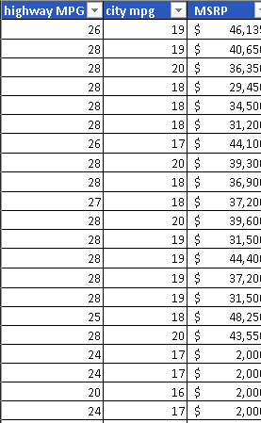
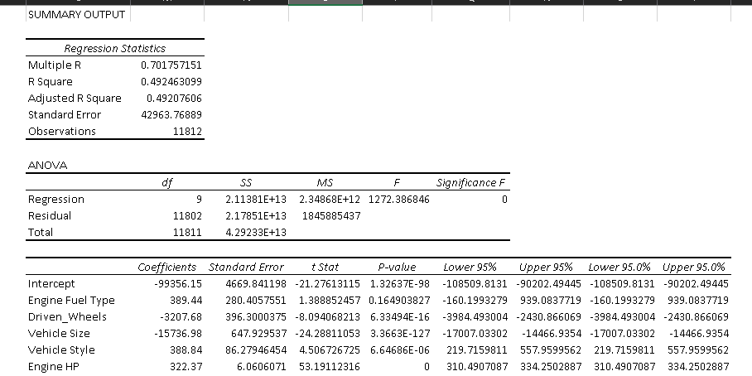
Task 3: Use regression analysis to identify the variables that have the strongest relationship with a car's price. Then create a bar chart that shows the coefficient values for each variable to visualize their relative importance.

Slide 8
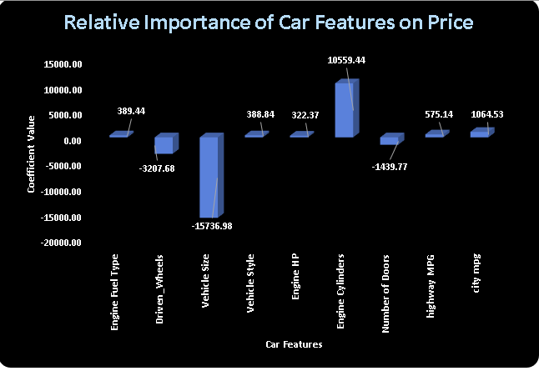
Bar chart

Slide 9
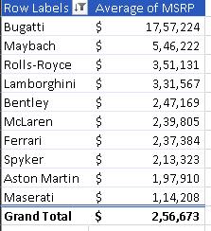
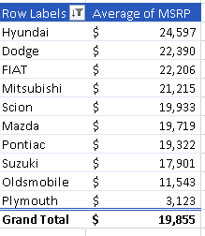
Task 4.A: Create a pivot table that shows the average price of cars for each manufacturer.

Slide 10
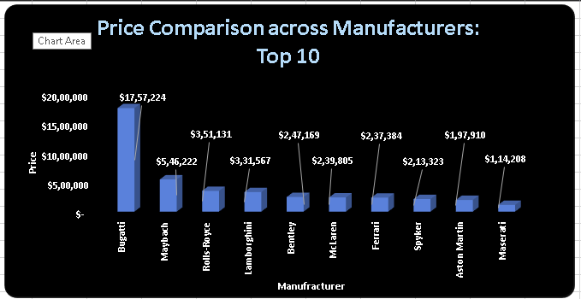
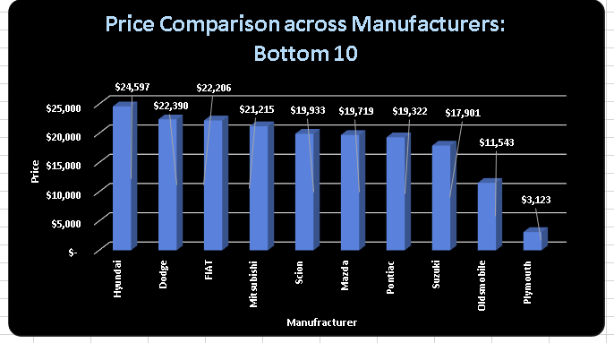
Task 4.B: Create a bar chart or a horizontal stacked bar chart that visualizes the relationship between manufacturer and average price.

Slide 11
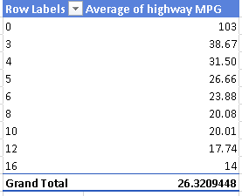
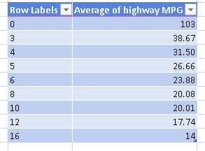
Task 5.A: Create a scatter plot with the number of cylinders on the x-axis and highway MPG on the y-axis. Then create a trendline on the scatter plot to visually estimate the slope of the relationship and assess its significance.

Slide 12
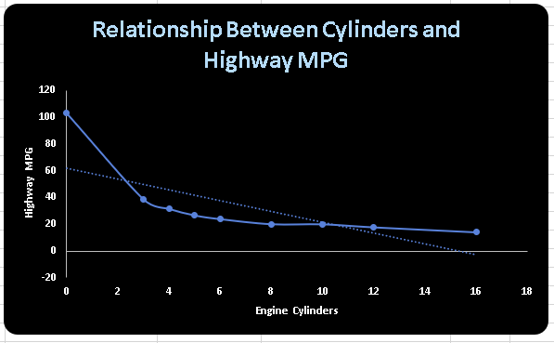
Task 5.B: Calculate the correlation coefficient between the number of cylinders and highway MPG to quantify the strength and direction of the relationship.

Slide 13
Building the Dashboard:
D_Task- 1: How does the distribution of car prices vary by brand and body style?
D_Task- 2: Which car brands have the highest and lowest average MSRPs, and how does this vary by
body style?
D_Task- 3: How do the different feature such as transmission type affect the MSRP, and how does this
vary by body style?
D_Task- 4: How does the fuel efficiency of cars vary across different body styles and model years?
D_Task- 5: How does the car's horsepower, MPG, and price vary across different Brands?
Since some of the solutions cannot be shown fully because of size and quality constraint of the screenshot therefore the drive link for the excel File is pasted here for full solution and reference.
LINK:
https://drive.google.com/file/d/1OvyTUdsMU-BAvG7ppN4n5bkmptId4SQF/view?usp=sharing

Slide 14
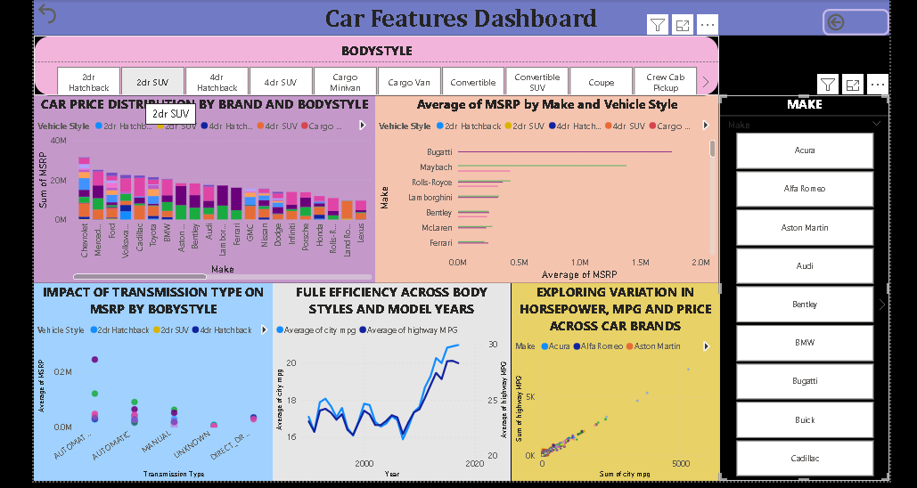

Slide 15
Thank you

